Slide 1
Sanborn Regional School District Every Child... Every Chance... Every Day
Superintendent’s Proposed Budget
FY 2017-18
Presented to School Board and Budget Committee
November 9, 2016
Notes:
Open both meetings
Welcome everyone
Do introductions of everyone Board, Budget Committee and Admin.

Slide 3
Goals for this Evening
Tell the “Sanborn Story”
Understand what’s in the Budget Document
Dispel misinformation for the public
Capture positive things happening in Sanborn

Slide 4
Proposed Budget vs. Default Budget
Administrative Proposed Budget * $36,755,580
Superintendent’s Proposed Budget $34,682,187
Default Budget (Per RSA 40:13, IX (b) $34,723,540
Difference ($41,353.)
Increase over current budget $116,291. or .33%

Slide 5
Sanborn Regional High School Mr. Brian Stack, Principal

Slide 6
SRHS Staffing/Class Size Considerations
What are the challenges?
What impact does the school’s bell schedule have?
What would be the impact be if teacher reductions were made in every subject?
How does the school’s staffing level compare to other New Hampshire high schools?

Slide 7
Curriculum, Instruction and Assessment Ms. Ellen Hume-Howard, Director

Slide 8
2016 District Chromebook Implementation
Chromebook | Focus Use | Impact | Overall Savings
INSTRUCTION | Textbooks and instructional materials available on the Chromebook for students Students use the Chromebook to do research and write | Instructional materials updated in real time, including multiple resources beyond one textbook series Student work can be reviewed and monitored by teacher for immediate feedback and assessment purposes | Textbook budget decreased. Online licenses and subscriptions replace textbook purchases No need to buy new texts to ensure update information for students Student and teacher time is utilized more efficiently
TECHNOLOGY | Use of the CLOUD for storage where there is unlimited storage Replace costs for Chromebooks vs. Laptops Software available through APPs | Decreases the need for server storage at the district level Cost for Chromebook to replace laptops- a savings of $750 per device Available APPs for free replace current software needs | Cost for storage is $0 Savings to technology replacement plan for devices, replacement of computer lab devices Savings in the purchase of software
RESOURCES | Printing minimized as both student product and teacher instructional materials are in the Google Classroom | Decreases need to print materials or student work | Printing costs decreased in the technology budget

Slide 9
Student Services Ms. Jodi Gutterman, Director

Slide 10
Student Services Adjustments
Some facts on the Student Services budget
Reductions to program
Additions/changes to program
Impact of Competency Education on Student Services

Slide 11
Fixed Costs Ms. Carol Coppola, Business Administrator

Slide 12
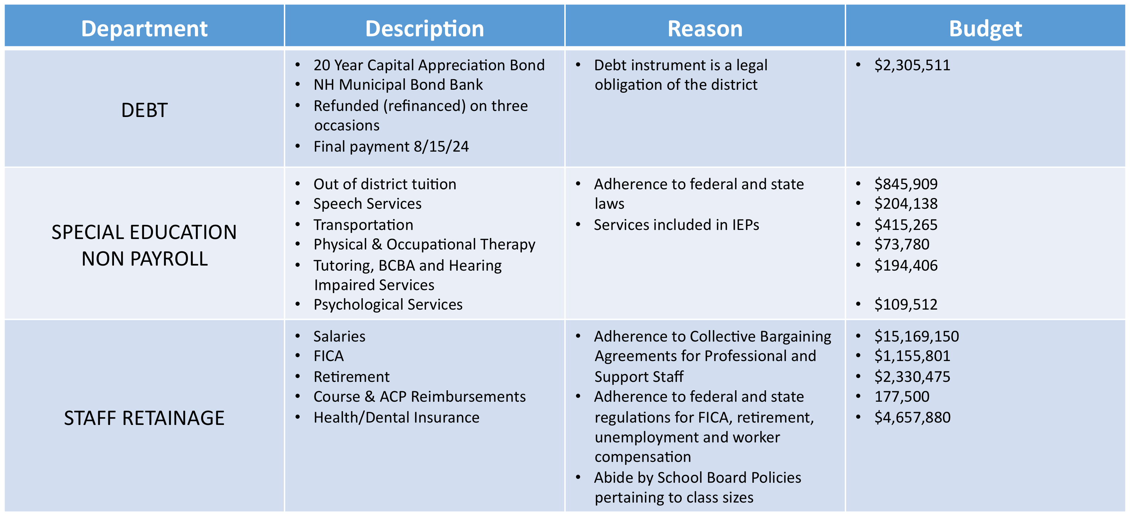
Operating Budget Fixed Costs

Slide 13
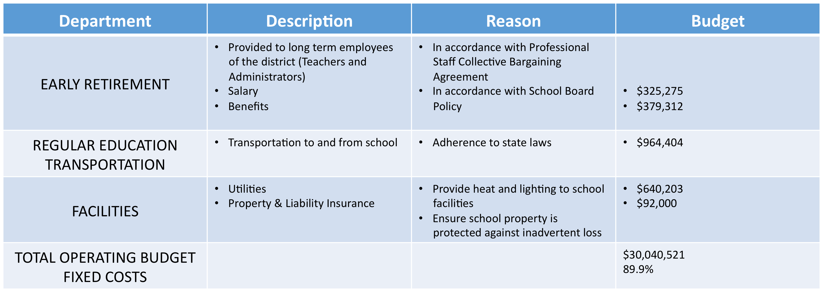
Operating Budget Fixed Costs

Slide 14
Average Homeowner Property Taxes
Average Homeowner Assessed Valuation of $250,000

Slide 15
Budget Document Highlights
Page 8: 17 Reasons to Celebrate
Pages 10-13 School Board Goals
Page 80 has all of the Additions and Deletions
Page 301 is the Capital Improvement Plan
Page 313 starts the Capital Replacement Plan
Page 329 Default Budget calculation
Page 333 Community profile information

Slide 16
Thank you! Questions?

